Slide 1
Constraint Programming:
What is behind?
Roman Barták
Charles University, Prague
bartak@kti.mff.cuni.cz

Slide 2
Quotations
“Constraint programming represents one of the closest approaches computer science has yet made to the Holy Grail of programming: the user states the problem, the computer solves it.”
Eugene C. Freuder, Constraints, April 1997
“Were you to ask me which programming paradigm is likely to gain most in commercial significance over the next 5 years I’d have to pick Constraint Logic Programming, even though it’s perhaps currently one of the least known and understood.”
Dick Pountain, BYTE, February 1995

Slide 3
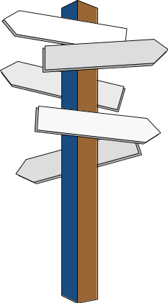
Talk Schedule
Historical context
Constraint technology
  basic features
  constraint satisfaction
  constraints in optimisation
  over-constrained problems
Applications
Summary
  Advantages & Limitations
Trends
Resources

Slide 4

The Origins
Artificial Intelligence
  Scene Labelling (Waltz)
Interactive Graphics
  Sketchpad (Sutherland)
  ThingLab (Borning)
Logic Programming
  unification --> constraint solving
Operations Research
  NP-hard combinatorial problems

Slide 5
Scene Labelling
first constraint satisfaction problem
Task:
recognise objects in 3D scene by interpreting lines in 2D drawings
Waltz labelling algorithm
  legal labels for junctions only
  the edge has the same label at both ends
+
+
+
+
-
-
+
+
+
+

Slide 6
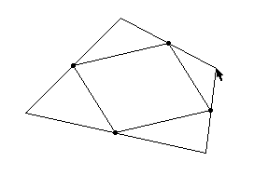
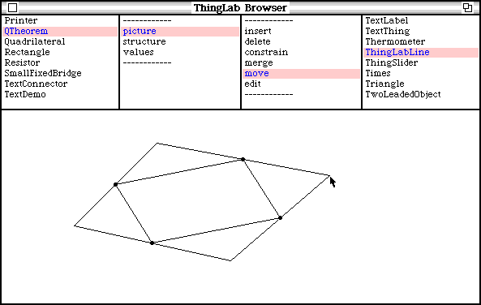
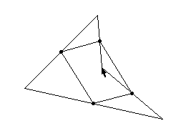
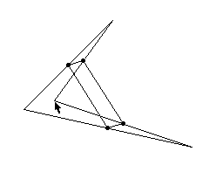
Interactive Graphics
Sketchpad (Sutherland)
ThingLab (Borning)
  allow to draw and manipulate constrained geometric figures in the computer display

Slide 7
What is CP?
CP = Constraint Programming
  stating constraints about the problem variables
  finding solution satisfying all the constraints
constraint = relation among several unknowns
Example: A+B=C, X>Y, N=length(S) …
Features:
  express partial information X>2
  heterogeneous N=length(S)
  non-directional X=Y+2: X← Y+2 ∨ Y←X-2
  declarative manner “
  additive X>2,X<5 ⇔ X<5,X>2
  rarely independent A+B=5, A-B=1

Slide 8
Solving Technology
Constraint Satisfaction
  finite domains -> combinatorial problems
  95% of all industrial applications
Constraints Solving
  infinite or more complex domains
  methods
    automatic differentiation, Taylor series, Newton method
  many mathematicians deal with whether certain constraints are satisfiable
  (Fermat’s Last Theorem)

Slide 9
Constraint Satisfaction Problem
Consist of:
  a set of variables X={x₁,…,x_{n}}
  variables’ domains D_{i} (finite set of possible values)
  a set of constraints
  Example:
    X::{1,2}, Y::{1,2}, Z::{1,2}
    X = Y, X ≠ Z, Y > Z
Solution of CSP
  assignment of value from its domain to every variable satisfying all the constraints
  Example:
    X=2, Y=2, Z=1

Slide 10
Systematic Search Methods
exploring the solution space
complete and sound
efficiency issues
Backtracking (BT)
Generate & Test (GT)
exploring subspace
exploring
individual assignments
Z
Y
X

Slide 11
Generate & Test
Systematic Search Methods
probably the most general problem solving method
Algorithm:
  generate labelling
  test satisfaction
Drawbacks: Improvements:
  blind generator smart generator
  --> local search
  late discovery of testing within generator
  inconsistencies --> backtracking

Slide 12
Backtracking (BT)
Systematic Search Methods
incrementally extends a partial solution towards a complete solution
Algorithm:
  assign value to variable
  check consistency
  until all variables labelled
Drawbacks:
  thrashing
  redundant work
  late detection of conflict
A
1
B
1
2
C
1
2
1
D
1
2
1
2
1
√
A = D, B ≠ D, A+C < 4

Slide 13
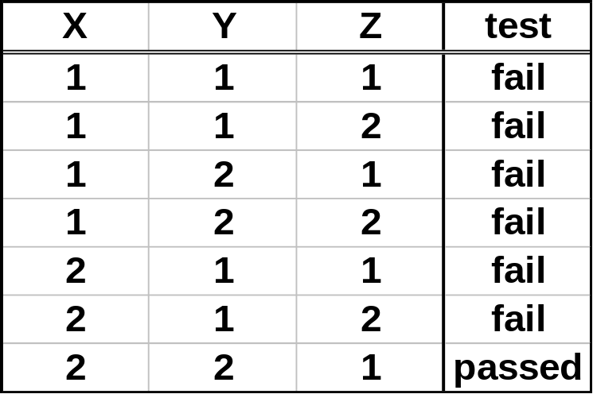
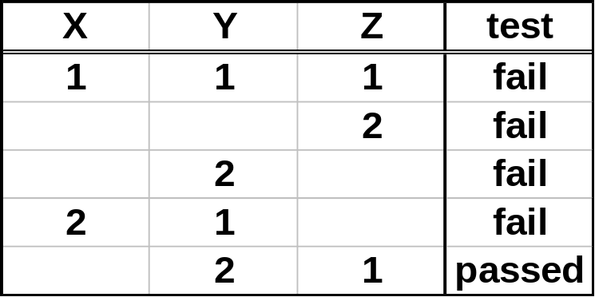

GT & BT - Example
Systematic Search Methods
Problem:
X::{1,2}, Y::{1,2}, Z::{1,2}
X = Y, X ≠ Z, Y > Z
generate & test backtracking

Slide 14
Consistency Techniques
removing inconsistent values from variables’ domains
graph representation of the CSP
  binary and unary constraints only (no problem!)
  nodes = variables
  edges = constraints
node consistency (NC)
arc consistency (AC)
path consistency (PC)
(strong) k-consistency
A>5
A
A≠B
A<C
C
B
B=C

Slide 15
Arc Consistency (AC)
Consistency Techniques
the most widely used consistency technique (good simplification/performance ratio)
deals with individual binary constraints
repeated revisions of arcs
AC-3, AC-4, Directional AC
a
b
c
a
b
c
a
b
c
X
Y
Z

Slide 16
AC - Example
Consistency Techniques
Problem:
X::{1,2}, Y::{1,2}, Z::{1,2}
X = Y, X ≠ Z, Y > Z
X
X
1 2
1 2
1 2
1 2
Y
Y
1 2
1 2
Z
Z

Slide 17

Is AC enough?
Consistency Techniques
empty domain => no solution
cardinality of all domains is 1 => solution
Problem:
X::{1,2}, Y::{1,2}, Z::{1,2}
X ≠ Y, X ≠ Z, Y ≠ Z
X
1 2
1 2
Y
Z
1 2

Slide 18
Path Consistency (PC)
Consistency Techniques
consistency along the path only
checking paths of length 2 is enough
Plus/Minus
  + detects more inconsistencies than AC
  - extensional representation of constraints
  - changes in graph connectivity
Directional PC, Restricted PC
V₂
V₃
V₄
V₅
V₀
V₁
???

Slide 19
K -consistency
Consistency Techniques
K-consistency
  consistent valuation o (K-1) variables can be extended to K-th variable
strong K-consistency
≡ J-consistency for each J≤K
NC ≡ strong 1-consistency
AC ≡ strong 2-consistency
PC ≡ strong 3-consistency

Slide 20
Consistency Completeness
strongly N-consistent constraint graph with N nodes => solution
strongly K-consistent constraint graph with N nodes (K<N) => ???
path consistent
but no solution
Special graph structures
  tree structured graph => (D)AC is enough
  cycle cutset, MACE
≠
A
D
{1,2,3}
{1,2,3}
≠
≠
≠
≠
B
≠
C
{1,2,3}
{1,2,3}

Slide 21
Constraint Propagation
systematic search only => no efficient
consistency only => no complete
combination of search (backtracking) with consistency techniques
methods:
  look back (restoring from conflicts)
  look ahead (preventing conflicts)
look back
look ahead
Labelling order

Slide 22
Look Back Methods
Constraint Propagation
intelligent backtracking
consistency checks among instantiated variables
backjumping
  backtracks to the conflicting variable
backchecking and backmarking
  avoids redundant constraint checking
  by remembering conflicting level
  for each value
jump here
a
conflict
b
b
b
still conflict

Slide 23
Look Ahead Methods
Constraint Propagation
preventing future conflicts via consistency checks among not yet instantiated variables
forward checking (FC)
  AC to direct neighbourhood
partial look ahead (PLA)
  DAC
(full) look ahead (LA)
  Arc Consistency
  Path Consistency
instantiated variable
labelling order

Slide 24
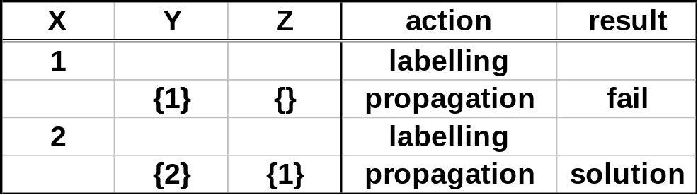
Look Ahead - Example
Constraint Propagation
Problem:
X::{1,2}, Y::{1,2}, Z::{1,2}
X = Y, X ≠ Z, Y > Z
generate & test - 7 steps
backtracking - 5 steps
propagation - 2 steps

Slide 25
Stochastic and Heuristic Methods
GT + smart generator of complete valuations
local search - chooses best neighbouring configuration
  hill climbing
  neighbourhood = value of one variable changed
  min-conflicts
  neighbourhood = value of selected conflicting variable
  changed
avoid local minimum => noise heuristics
  random-walk
  sometimes picks neighbouring configuration randomly
  tabu search
  few last configurations are forbidden for next step
does not guarantee completeness

Slide 26
Connectionist approach
Artificial Neural Networks
  processors (cells) = <variable,value>
  on state means “value is assigned to the variable”
  connections = inhibitory links between incompatible pairs
GENET
  starts from random configuration
  re-computes states using neighbouring cells
  till stable configuration found (equilibrium)
  learns violated constraints by strengthening weights
Incomplete (oscillation)
1
values
2
X
Y
Z
variables

Slide 27
Constraint Optimisation
looking for best solution
quality of solution measured by application dependent objective function
Constraint Satisfaction Optimisation Problem
  CSP
  objective function: solution -> numerical value
  Note: solution = complete labelling satisfying all the constraints
Branch & Bound (B&B)
  the most widely used optimisation algorithm

Slide 28
Branch & Bound
Constraint Optimisation
depth first search (like BT)
+ under estimate of the objective function (minimisation)
+ bound (initially set to plus infinity)
heuristic function:
partial labelling -> under estimate of the objective function
pruning sub-tree under the partial labelling when
  constraint inconsistency detected
  heuristic value exceeds the bound
efficiency is determined by:
  the quality of the heuristic function
  whether a good bound is found early


Slide 29
Over-Constrained Problems
What solution should be returned when
no solution exists?
impossible satisfaction of all constraints because of inconsistency
Example: X=5, X=4
Solving methods
  Partial CSP (PCSP)
  weakening original CSP
  Constraint Hierarchies
  preferential constraints

Slide 30
Dressing Problem
Over-Constrained Problems
shirt: {red, white}
footwear: {cordovans, sneakers}
trousers: {blue, denim, grey}
shirt x trousers: red-grey, white-blue, white-denim
footwear x trousers: sneakers-denim, cordovans-grey
shirt x footwear: white-cordovans
red white
shirt
blue denim grey
trousers
footwear
cordovans sneakers

Slide 31
Partial CSP
Over-Constrained Problems
weakening a problem:
  enlarging the domain of variable
  enlarging the domain of constraint √
  removing a variable
  removing a constraint
one solution
  white - denim - sneakers
shirt
red white
enlarged constraint’s domain
blue denim grey
trousers
footwear
cordovans sneakers

Slide 32
Partial CSP
Over-Constrained Problems
Partial Constraint Satisfaction Problem
  CSP
  evaluation function: labelling -> numerical value
Task:
find labelling optimal regarding the evaluation function
Example: maximising number of satisfied constraints
Usage:
  over-constrained problems
  optimisation problems (PCSP is a generalisation of CSOP)
  obtaining “good enough” solution within fixed time

Slide 33
Constraint Hierarchies
Over-Constrained Problems
constraints with preferences
solution respects the hierarchy
  weaker constraints do not cause dissatisfaction of stronger constraint
shirt x trousers @ required
footwear x trousers @ strong
shirt x footwear @ weak
two solutions
  red - grey - cordovans
  white - denim - sneakers
shirt
red white
blue denim grey
trousers
footwear
cordovans sneakers

Slide 34
Constraint Hierarchies
Over-Constrained Problems
Hierarchy = (finite) set of labelled constraints
  levels H_{i} (H₀ - required constraints, H₁ - strongest non required …)
Solution:
  S₀={σ | all required constraints are satisfied by σ }
  S_{H}={σ | σ ∈ S₀ s.t. ∀ θ ∈ S₀ ¬ better(θ,σ,H) }
  where better - comparator (partial ordering of valuations)
solving methods:
  refining method (DeltaStar)
    solve constraints from stronger to weaker levels
  local propagation (DeltaBlue, SkyBlue)
    repeatedly selects uniquely satisfiable constraints
    planning + value propagation
hierarchies in optimisation problems
  weak constraint objective function = optimum

Slide 35

Applications
assignment problems
  stand allocation for airports
  berth allocation to ships
  personnel assignment
    rosters for nurses
    crew assignment to flights
network management and configuration
  planning of cabling of telecommunication networks
  optimal placement of base stations in wireless networks
molecular biology
  DNA sequencing
analogue and digital circuit design

Slide 36
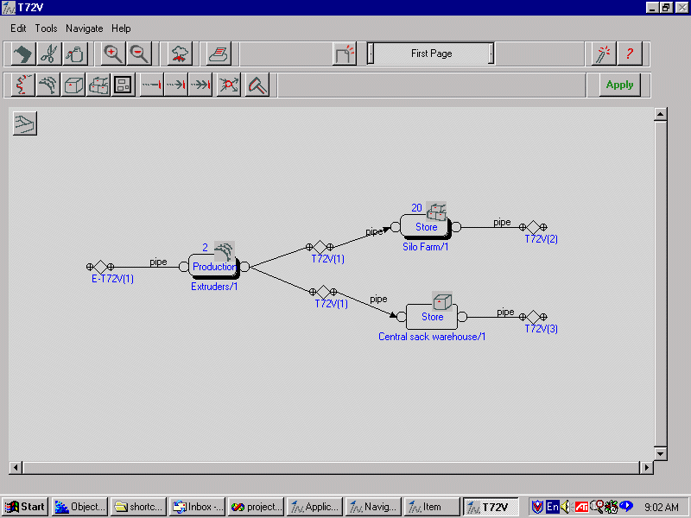
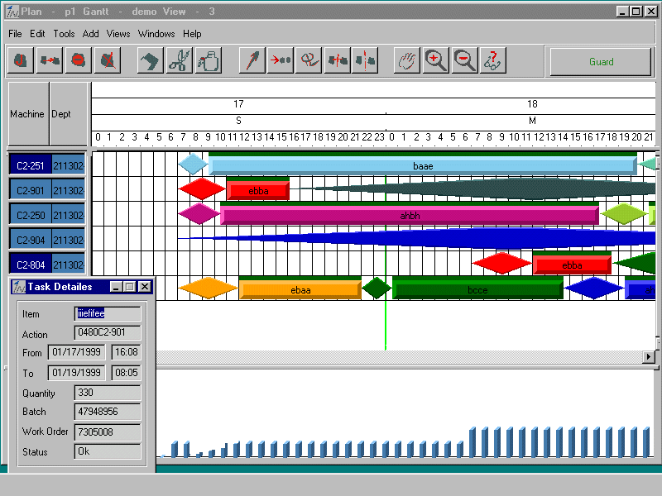
Scheduling Problems
the most successful application area
production scheduling (InSol Ltd.)
well-activity scheduling (Saga Petroleum)
forest treatment scheduling
planning production of jets (Dassault Aviation)

Slide 37

Advantages
declarative nature
  focus on describing the problem to be solved, not on specifying how to solve it
co-operative problem solving
  unified framework for integration of variety of special-purpose algorithms
semantic foundation
  amazingly clean and elegant languages
  roots in logic programming
applications
  proven success

Slide 38

Limitations
NP-hard problems & tracktability
unpredictable behaviour
model stability
too high-level
(new constraints, solvers, heuristics)
too low-level (modelling)
too local
non-incremental (rescheduling)
weak solver collaboration

Slide 39
Trends
modelling
  global constraints (all_different)
  modelling languages (Numerica, VisOpt)
understanding search
  visualisation, performance debugging
hybrid algorithms
solver collaboration
parallelism
multi-agent technology

Slide 40

Resources
Conferences
  Principles and Practice of Constraint Programming (CP)
  The Practical Application of Constraint Technologies and Logic Programming (PACLP)
Journal
  Constraints (Kluwer Academic Publishers)
Internet
  Constraints Archive
  http://www.cs.unh.edu/ccc/archive
  Guide to Constraint Programming
  http://kti.mff.cuni.cz/~bartak/constraints/

